Slide 1
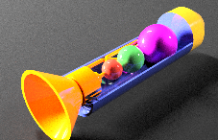
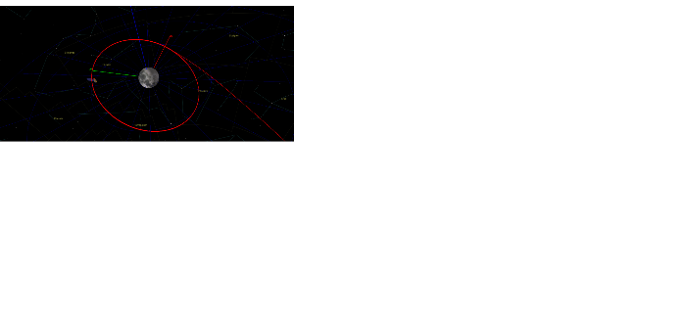

Lunar Orbit Engine
Mission objective and introduction
Translunar Orbit Injection to Low Lunar Orbit with a payload of 3000kg
Approximate Delta V of 800 m/s
Launch Vehicle: H-II-A
4614kg
Propulsion system design
Hydrazine/NTO, 1132kg
Regulated Gas Feed System
Cooling system
Propellant storage
Combustion analysis and results
Stoichiometric reaction
Combines NTO and Hydrazine
Actual reaction with your O-to-F ratio
3
Adiabatic flame temperature
2505.57 K
Elementary reactions
H,H2O,N2,O2,HO2,NO,O,H2,NO2,OH
Nozzle design and thrust
500 N
267s

